Slide 1

Capstone Project – I: Review – 1 on
Enhance the security and privacy of Federated Learning systems
Presented by the Batch No. : CSE-24
A.ANITHA - BU22CSEN0101001
V.NIRANJAN - BU22CSEN0101209
G.B. NAMITHA - BU22CSEN0100875
C.PURUSHOTHAM SAI - BU22CSEN0100356
Under the Guidance of
Parikshith Nayak S K
Assistant Professor
Department of Computer Science and Engineering
GITAM School of CSE, GITAM (Deemed to be University),
Bengaluru, Karnataka, INDIA.

Slide 2
CONTENTS
Abstract
Introduction
Literature Survey
Problem Statements
Objectives
Work Breakdown & Task Allocation
Timeline & Milestones (Gantt Chart)
Conclusion
References

Slide 3
Abstract
This project focuses on enhancing the security and privacy of Federated Learning (FL) systems. By implementing encryption techniques and digital signatures, client updates are protected during transmission and verified for authenticity, ensuring that only trusted participants contribute to the global model. The approach safeguards sensitive data while maintaining collaborative model training. A federated logistic regression model is used to demonstrate how secure updates improve the reliability and performance of the global model. This framework provides a robust and trustworthy FL solution suitable for privacy-sensitive applications such as healthcare, finance, and IoT.

Slide 4
Introduction
Machine Learning (ML) has become a key technology for analyzing information and making predictions. Traditional ML approaches require collecting all data in a central server, which can lead to serious privacy and security risks, especially when handling sensitive data from healthcare, finance, or personal devices.
Federated Learning (FL) is an advanced approach where data remains on local devices, and only model updates are shared with a central server. This allows multiple devices or organizations to collaboratively train a global model while keeping their data private.
Despite its privacy benefits, FL faces several security challenges:
Data leakage during update transmission.
Malicious clients sending fake or poisoned updates to disrupt the global model.
Integrity attacks, where unauthorized changes affect model accuracy.

Slide 5
Introduction..contd
Our project focuses on enhancing the security and privacy of Federated Learning systems by:
Using encryption to protect model updates during transmission.
Applying digital signatures to ensure the authenticity and integrity of updates.
The goal is to create a robust, secure, and privacy-preserving FL framework that can be applied in sensitive areas like healthcare, finance, IoT devices, and smart applications, ensuring both data confidentiality and model reliability.

Slide 6
Literature Survey
Table 1: Literature Survey
S. No. | paper Details | Summary | Techniques/Algorithms Used | Research Gap
1 | TITLE: Security and Privacy-Enhanced federated learning for anomaly detection in IoT. AUTHORS: Cui, L., Qu, Y., Xie, G., Zeng, D., Li, R., Shen, S., & Yu, S. YEAR: (2012) | Blockchain-enabled decentralized federated learning with DP-GAN achieves >95% IoT anomaly detection accuracy while enhancing security, privacy, and robustnes | Asynchronous Federated Learning Blockchain Aggregation Differential Privacy GAN (DP-GAN) | High communication/computation overhead Limited real-world deployment Device/hyperparameter optimization needed Weak adversarial/poisoning defenses

Slide 7
Literature Survey…contd
Table 2: Literature Survey Contd…
S. No. | Paper Details | Summary | Techniques/Algorithms Used | Research Gap
2 | TITLE:Enhancing Brain Tumor Segmentation Accuracy through Scalable Federated Learning. AUTHORS:11(19), 4189. Ullah, F., Nadeem, M., Abrar, M., Amin, F., Salam, A., & Khan, S. YEAR:2023 | The paper proposes a federated learning framework with U-Net for privacy-preserving brain tumor segmentation, enabling accurate and scalable collaborative training across hospitals. | Federated Learning Secure Aggregation U-Net Architecture Dropout Tolerance Efficient Model Aggregation | High communication and computation overhead No inherent differential privacy Challenging to combine with differential privacy while maintaining utility and scalability

Slide 8
Literature Survey…contd
Table 3: Literature Survey Contd…
S. No. | Paper Details | Summary | Techniques/Algorithms Used | Research Gap
3 | TITLE:Enhancing the Security and Privacy in the IoT Supply Chain Using Blockchain and Federated Learning. AUTHORS:L Zhu, S Hu, X Zhu, C Meng, M Huang . YEAR: 2023 | The paper presents a blockchain-based federated learning framework to secure IoT supply chains, enabling decentralized model training with improved privacy, traceability, and data integrity. | Blockchain Federated Learning Smart Contracts Encryption | High communication and computation overhead Limited large-scale real-world deployment Scalability and interoperability challenges Need for stronger defenses against adversarial attacks

Slide 9
Literature Survey…contd
Table 4: Literature Survey Contd…
S. No. | Paper Details | Summary | Techniques/Algorithms Used | Research Gap
4 | TITLE:Enhancing privacy-preserving intrusion detection through federated learning. AUTHORS:A Alazab, A Khraisat, S Singh, T Jan YEAR : 2023 | The paper proposes a federated learning framework for privacy-preserving intrusion detection, enabling collaborative model training across distributed networks without sharing raw data, while maintaining high detection accuracy. | Federated Learning Secure Aggregation Differential Privacy Intrusion Detection Models (e.g., CNN/RNN) | High communication and computation overhead Limited real-world deployment and scalability Vulnerability to adversarial/poisoning attacks Need for optimized model and device resource management

Slide 10
Problem Statements
Secure & Efficient Multi-Party Aggregation at Scale
Secure aggregation protocols protect individual updates from the central server but introduce significant communication and computation overhead, limiting deployment on bandwidth-constrained or mobile devices.
Goal: Create a lightweight, dropout-resilient secure aggregation scheme that offers strong cryptographic guarantees while reducing computational cost and communication rounds.
Challenge: High bandwidth use, complex key exchanges, and client dropouts slow training.
Need: A lighter, dropout-resilient protocol that preserves strong cryptographic guarantees with much lower overhead.

Slide 11
Objectives
Lightweight Secure Aggregation: One-round additive masking with symmetric keys to cut bandwidth and computation.
Dropout Resilience: Threshold secret sharing so the aggregate is recoverable even if clients drop.
Low Overhead: Compress/quantize updates before masking to reduce communication.
Strong Security: Maintain formal cryptographic guarantees with minimal key-exchange setup.
Scale to Large Networks: Support thousands of heterogeneous or mobile devices with hierarchical or asynchronous aggregation.
Enhance Robustness: Add privacy-preserving defenses against adversarial or poisoning attacks without increasing overhead.

Slide 12
Work Breakdown & Task Allocation
Team Lead – A.Anitha
Project initiation and Planning.
Tasks:Defining project scope, setting objectives, preparing a project plan, allocating resources, identifying risks, and scheduling milestones.
Elaboration: This member ensures smooth initiation of the project, clear planning, and coordination among team members to achieve project goals.

Slide 13
Work Breakdown & Task Allocation
TM2- V.Niranjan
Project Documentation, Presentation, Evaluation & Closure.
Documentation: Prepare user manuals, technical reports, and record methodology.
Presentation & Evaluation:Create slides, demonstrate the project, and answer queries during evaluation.
Closure:Summarize lessons learned, release resources, and formally close the project.
Elaboration:This member ensures knowledge is recorded, the project is communicated effectively, and proper closure is done.

Slide 14
Work Breakdown & Task Allocation
TM3-G.B Namitha
Project Design and Development
Tasks:Define project objectives, scope, and deliverables. Identify stakeholders and project requirements. Conduct feasibility analysis and risk assessment.
Elaboration:This member ensures the project has a clear goal and roadmap before starting, including understanding client/user needs and potential constraints.

Slide 15
Work Breakdown & Task Allocation
TM4- C.PURUSHOTHAM SAI
Testing & Validation
Tasks: Develop test cases, perform unit and integration testing, validate model accuracy, security, and privacy measures. Report bugs and suggest improvements.
Elaboration: This member ensures the project meets functional and performance requirements, emphasizing reliability and security.

Slide 16
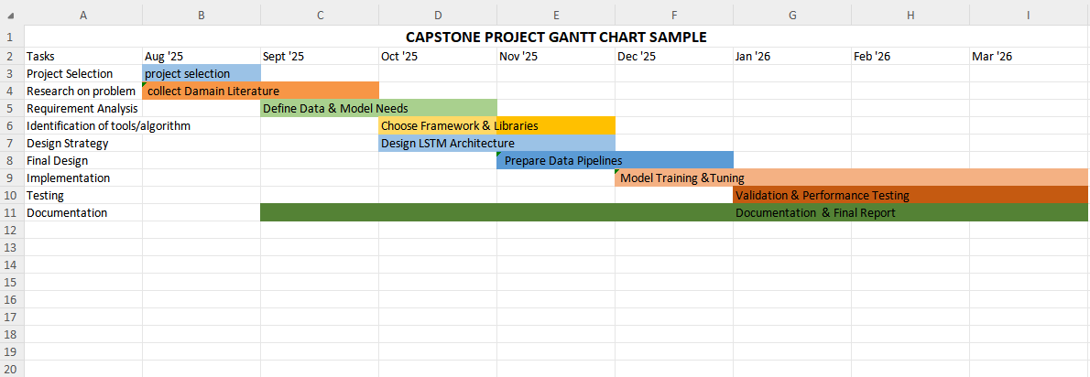
Timeline & Milestones (Gantt Chart)
capstone project Gantt Chart

Slide 17
Conclusion
Successfully implemented a secure Federated Learning system that keeps client data private and decentralized.
Ensured trustworthy updates by using digital signatures to verify the authenticity and integrity of each client contribution.
Developed a federated logistic regression model that performs reliably and maintains robustness even with multiple participants.
Enhanced privacy and security, protecting the system from unauthorized access, data leakage, and potential attacks.
Demonstrated the practical applicability of secure FL in sensitive domains such as healthcare, finance, and IoT devices.
Highlighted key strategies and best practices for deploying secure, privacy-preserving collaborative learning systems in real-world scenarios.

Slide 18
References
[1] Cui, L., Qu, Y., Xie, G., Zeng, D., Li, R., Shen, S., & Yu, S. (2021). Security and privacy-enhanced federated learning for anomaly detection in IoT infrastructures. IEEE Transactions on Industrial Informatics, 18(5), 3492-3500 [2] Ullah, F., Nadeem, M., Abrar, M., Amin, F., Salam, A., & Khan, S. (2023). Enhancing Brain Tumor Segmentation Accuracy through Scalable Federated Learning with Advanced Data Privacy and Security Measures. Mathematics, 11(19), 4189. https://doi.org/10.3390/math11194189. [3] Zhu, L., Hu, S., Zhu, X., Meng, C., & Huang, M. (2023). Enhancing the security and privacy in the IoT supply chain using blockchain and federated learning with trusted execution environment. Mathematics, 11(17), 3759. [4] Alazab, A., Khraisat, A., Singh, S., & Jan, T. (2023). Enhancing privacy-preserving intrusion detection through federated learning. Electronics, 12(16), 3382.

Slide 19
THANKYOU

